Slide 1
SC2001 LAB 1
Done by: Jaedon Chua, Bernard Efendy, Agnes Tan

Slide 2
Time Complexity
1

Slide 3
Merge Sort
W(1) = 0
W(n) = 2W(n/2) + n - 1
W(2^{k})= 2W(2^{k-1}) + 2^{k} - 1
= 2²W(2^{k-2}) + 2^{k} - 2 + 2^{k} - 1
= 2³W(2^{k-3}) + 3*2^{k} - 2² - 2 - 1
= 2³W(2^{k-3}) + 3*2^{k} - (2² - 2- 1)
...
= 2^{k}W(2^{k-k}) + k2^{k} - (2^{k} - 1)
= n*w(1) + logn * n - (n-1)
= 0 + nlogn - (n-1)
= O(nlogn)
Assume n = 2^{k}
Notes:
We first divide the input into two halves until we are left with sub-lists of 1 element. We will keep calling mergesort twice in each iteration for each half of the list 2W(n/2). Time complexity for merging 2 lists of size n back is O(n-1) since we would need to compare n times in the worst case scenario but the last remaining element wont need to be compared hence the -1.
We can write, W(n) = 2W(n/2) + n –1.
We write n as 2^k and we will have this equation. Then, we jus substitute the W(2^k-1) with itself using different values of k until we get this line.
We replace back 2^k with n and since there is a -(n-1), the time complexity will be bounded by nlogn.
Thus, the time complexity is big O of nlogn.

Slide 4
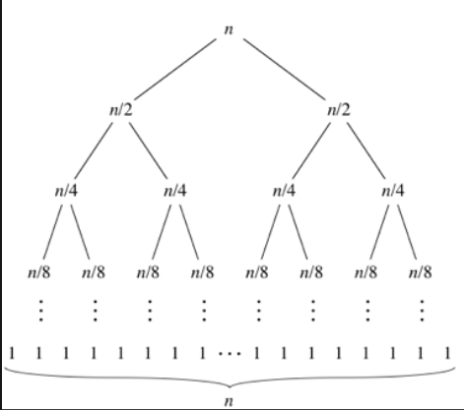
Hybrid Sort
Merge Sort
Merge Sort will split list into sub-lists of size S each
There will be n/S of such sub-list
Height of the recursion tree will be O(lgn), n is number of sub-lists at the bottom of the tree.
In this case, height of the tree is O(lgn/S)
At each height, n comparisons are made.
Thus, time complexity for merge sort portion of the hybrid sort is O(nlgn/S)
S S S S S S S S … S S S S S S S S

Slide 5
Hybrid Sort
Insertion Sort
The total cost of insertion sort for a list of N elements:
Best case: O(N)
Worst case: O(N²)
Since there are n/S of such lists each of size S, we get the total cost of applying insertion sort as:
Best case: (S) * n/S = O(n)
Worst case: (S²) * n/S = O(nS)
Thus, time complexity of hybrid sort:
Worst Case & Average Case: O(nS + nlog(n/S) )
Best Case: O(n + nlog(n/s) )

Slide 6
Optimal value of S
2

Slide 7
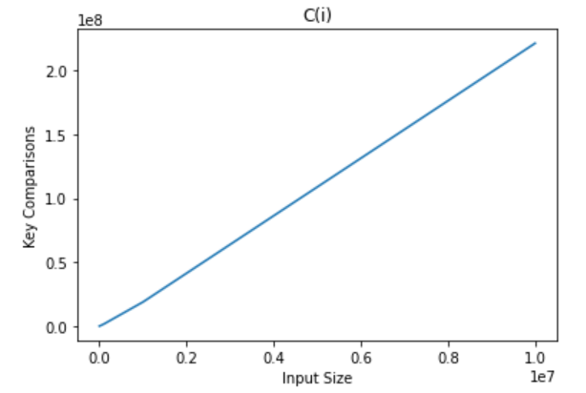
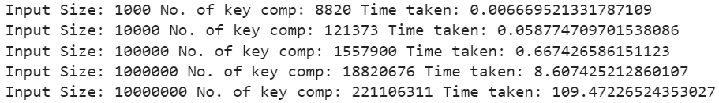
Graph #key comparisons against list size n
Fixed value of S = 10
Number of key comparisons is proportionate to input size of list

Slide 8
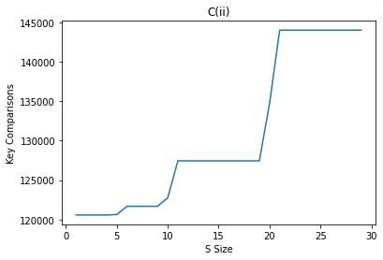
Graph #key comparisons against S value
Fixed value of n = 100,000
S ranges from 1 to 30
Number of key comparisons is increasing, proportional to S
Worst Case & Average Case: O(nS + nlog(n/S) )

Slide 9
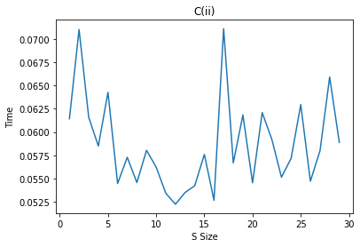
Graph #Time Taken against S value
Fixed value of n = 100,000
The runtime is lowest when S=12

Slide 10
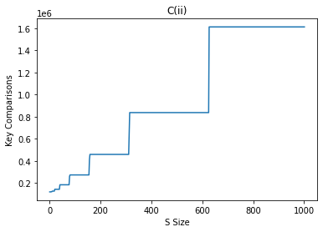
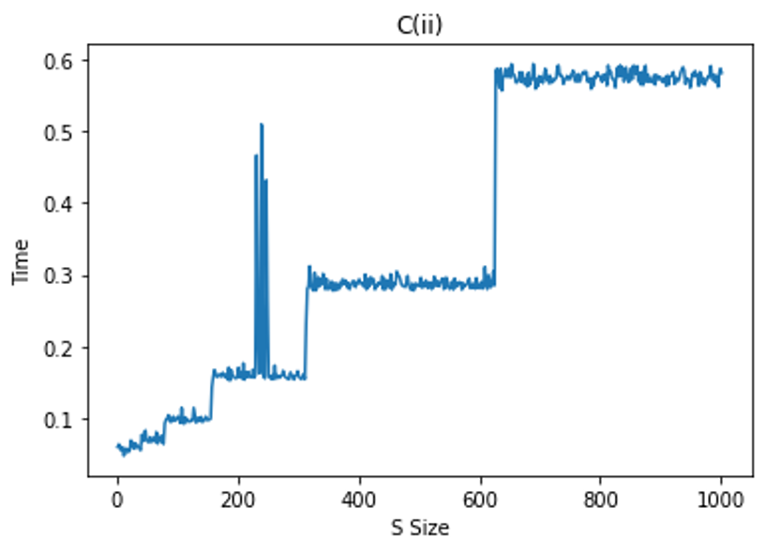
Graph #key comparisons against S value

Slide 11
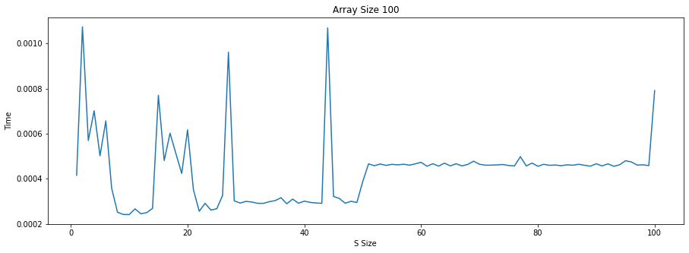
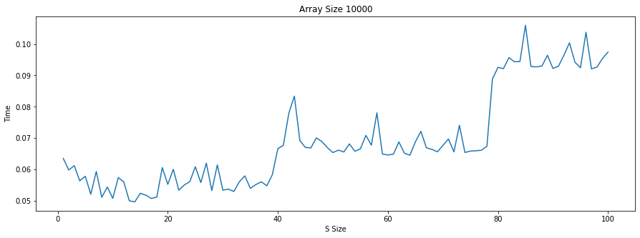
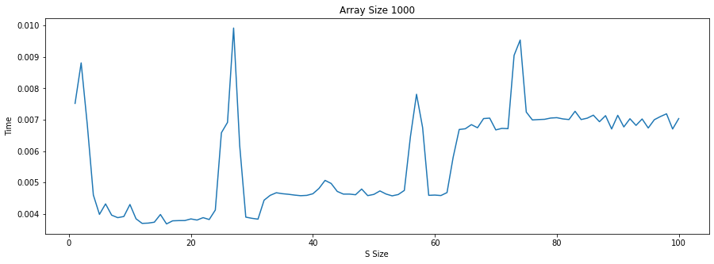
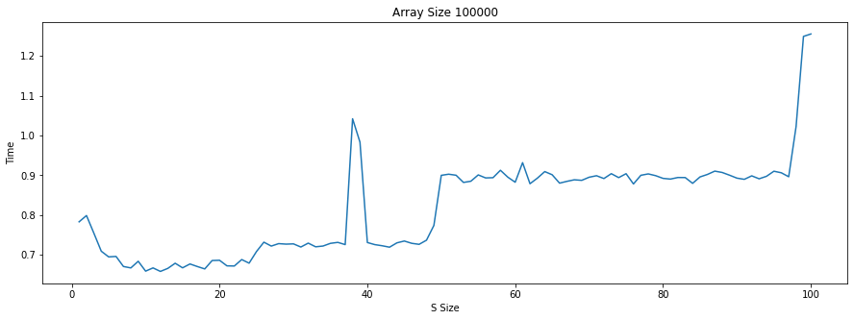
Graph #Time Taken against S value
Value of n = [100, 1000, 10000, 100000]

Slide 12
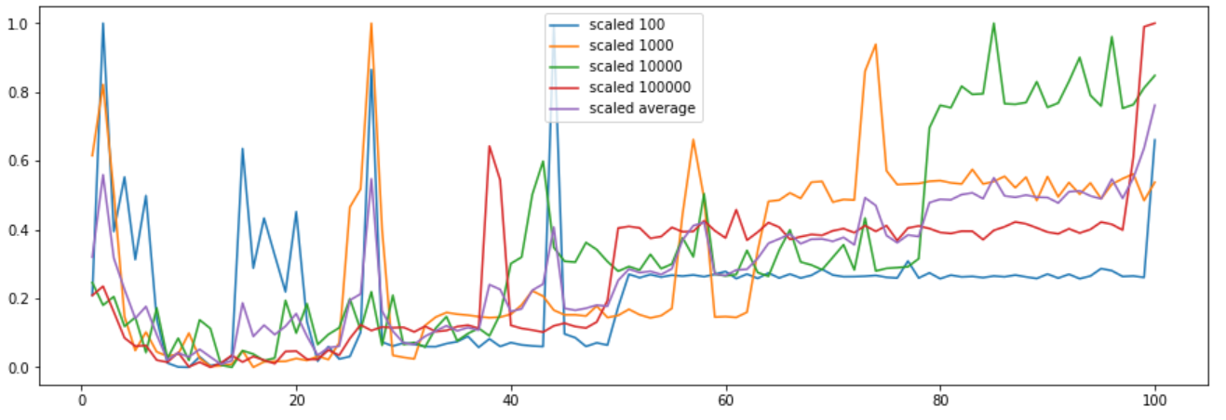
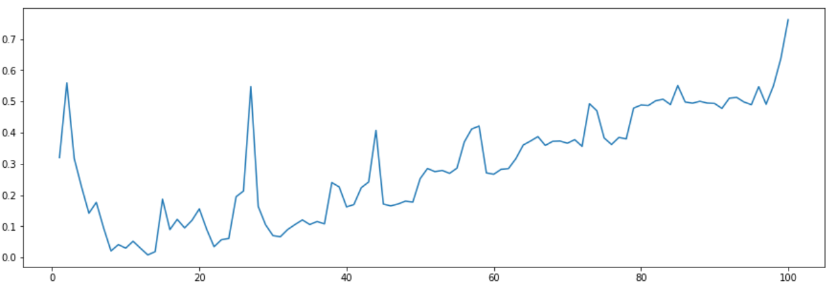
Graph #Time Taken against S value
Benchmarked using scaled average of n = [100, 1000, 10000, 100000]

Slide 13
Conclusion Best values of S
From this graph we have decided that the optimal value of S is in the range of 9 to 15.

Slide 14
Merge Sort vs Hybrid Sort
3

Slide 15
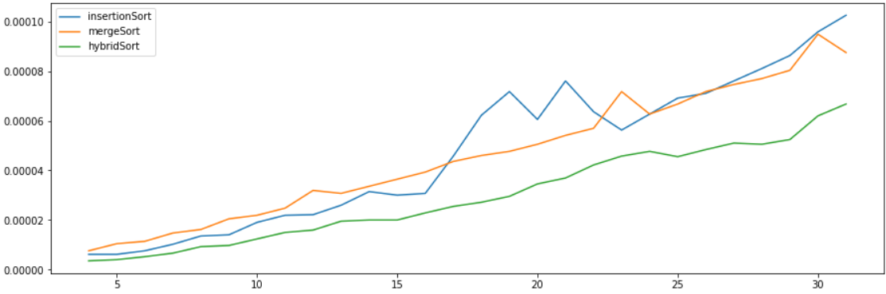
In theory...
Insertion sort has an advantage in runtime(ie speed) at low values of n over mergeSort
Swapping to insertion when the starting array has broken down into small subarrays in a mergeSort algorithm should lead to shorter runtimes and hence a more efficient algorithm

Slide 16


Merge Sort vs Hybrid Sort When n = 10 million
Merge Sort
Hybrid Sort

Slide 17
Merge Sort vs Hybrid Sort
S | % difference in time(3sf) | % difference in key-comp
9 | -9.05% | +0.458%
11 | -11.1% | +2.79%
13 | -8.16% | +2.87%
15 | -9.67% | +2.87%
Percentage difference
Hybrid – Merge
Merge

Slide 18
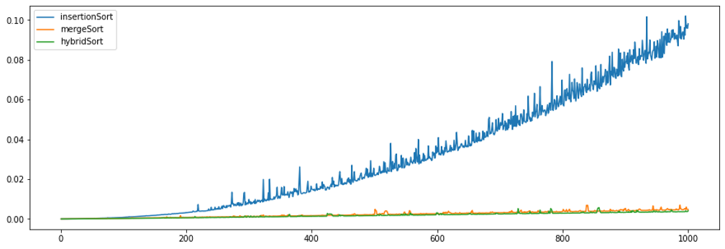
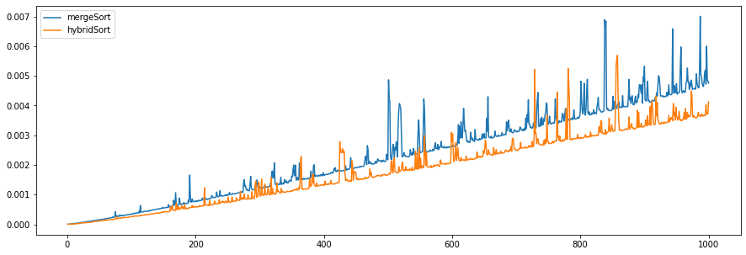
Comparing Every Sort Performance up to n=1,000

Slide 19
Results
Merge sort results in fewer number of comparisons done BUT takes longer to run.
Hybrid sort helps to save execution time in exchange for more key comparisons(by a smaller margin) meaning it creates a more efficient algorithm.

Slide 20
Thanks!
Any questions?

